Slide 1
Unit 7 : Mining Complex Types of Data
Lecturer : Bijay Mishra

Slide 2
Introduction
Mining complex types of data include:
Object data
Spatial data
Multimedia data
Time-series data
Text data
Web data

Slide 3
Spatial Data Mining
Spatial data mining is the process of discovering interesting, useful, non-trivial patterns from large spatial datasets.
Spatial Data Mining = Mining Spatial Data Sets (i.e. Data Mining + Geographic Information Systems)
Spatial data refer to any data about objects that occupy real physical space.
Attributes for spatial data usually will include spatial information. Spatial information (metadata) is used to describe objects in space.
Spatial information includes geometric metadata (e.g., location, shape, size, distance, area, perimeter) and topological metadata (e.g., “neighbor of”, “adjacent to”, “included in”, “includes”).
Spatial data can contain both spatial and non-spatial features. Spatial data has location or geo-referenced features like:
Address, latitude/longitude (explicit)
Location-based partitions in databases (implicit)

Slide 4
Spatial Data Mining
Spatial Data Warehouse is an integrated, subject-oriented, time-variant, and nonvolatile spatial data repository for data analysis and decision making.
Spatial Data Integration is a big issue. It deals with:
Structure-specific formats (raster vs. vector-based, Object-Oriented vs. relational models, different storage and indexing, etc.)
Vendor-specific formats (ESRI, MapInfo, Integraph, etc.)
Spatial Data Cube is a multidimensional spatial database where both dimensions and measures may contain spatial components

Slide 5
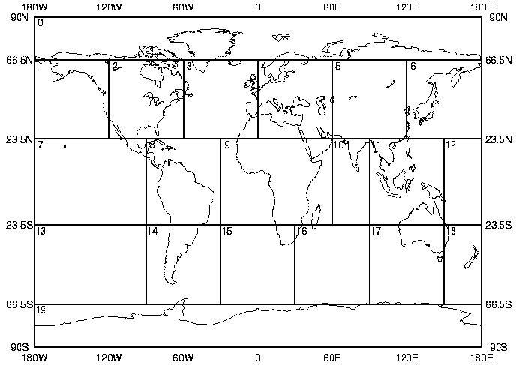
Spatial Data Mining
Regional Prior
Probability
Water
Coast
Land
Desert
Cloud
Snow/Ice
Glint

Slide 6
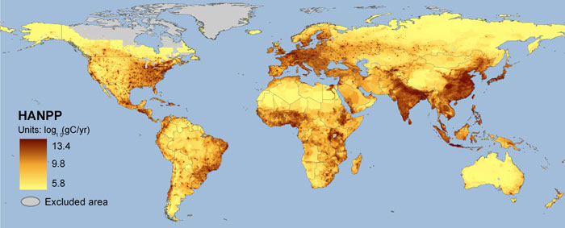
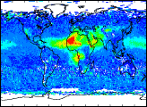
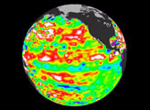
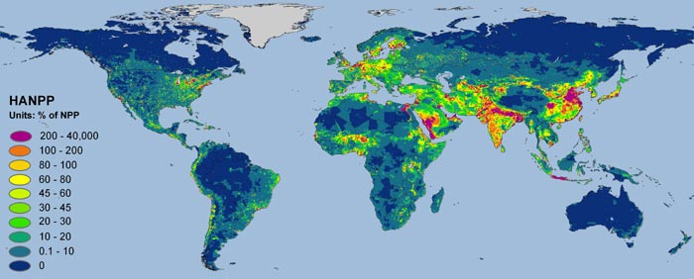
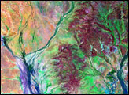
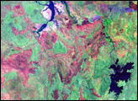
Special Cases
Image databases (Earth or the Sky)
Thematic maps (values of attributes or “themes” are displayed in a spatial distribution = a map!)

Slide 7
Spatial Classification and Spatial Trend Analysis
Spatial Classification
Analyze spatial objects to derive classification schemes, such as decision trees in relevance to certain spatial properties (district, highway, river, etc.)
Example: Classify regions in a province into rich vs. poor according to the average family income
Spatial Trend Analysis
Detect changes and trends along a spatial dimension
Study the trend of non-spatial or spatial data changing with space
Example: Observe the trend of changes of the climate or vegetation with the increasing distance from an ocean

Slide 8
Common Tasks dealing with Spatial Data
Data focusing
Spatial queries
Identifying interesting parts in spatial data
Progressive refinement can be applied in a tree structure
Feature extraction
Extracting important/relevant features for an application
Classification or others
Using training data to create classifiers
Many mining algorithms can be used
Classification, clustering, associations

Slide 9
Spatial Mining Tasks
Spatial classification
Spatial clustering
Spatial association rules

Slide 10
Spatial Classification
Use spatial information at different (coarse/fine) levels (different indexing trees) for data focusing
Determine relevant spatial or non-spatial features
Perform conventional supervised learning algorithms
e.g., Decision trees,

Slide 11
Spatial Clustering
Also called spatial segmentation
Use tree structures to index spatial data
Examples: DBSCAN: R-tree, CLIQUE: Grid or Quad tree, etc.
Input
a table of area names and their corresponding attributes such as population density, number of adult illiterates etc.
Information about the neighbourhood relationships among the areas
A list of categories/classes of the attributes
Output
Grouped (segmented) areas where each group has areas with similar attribute values

Slide 12
 |  |  |  | 2 | 2 | 2 | 2
 |  |  |  | 2 | 2 | 2 | 2
 |  |  |  | 2 | 2 | 2 | 2
1 | 1 | 1 | 1 | 2 | 2 | 2 | 2
1 | 1 | 1 | 1
1 | 1 | 1 | 1
1 | 1 | 1 | 1
Spatial segmentation is performed in image processing
Identify regions (areas) of an image that have similar colour (or other image attributes).
Many image segmentation techniques are available
E.g. region-growing technique

Slide 13
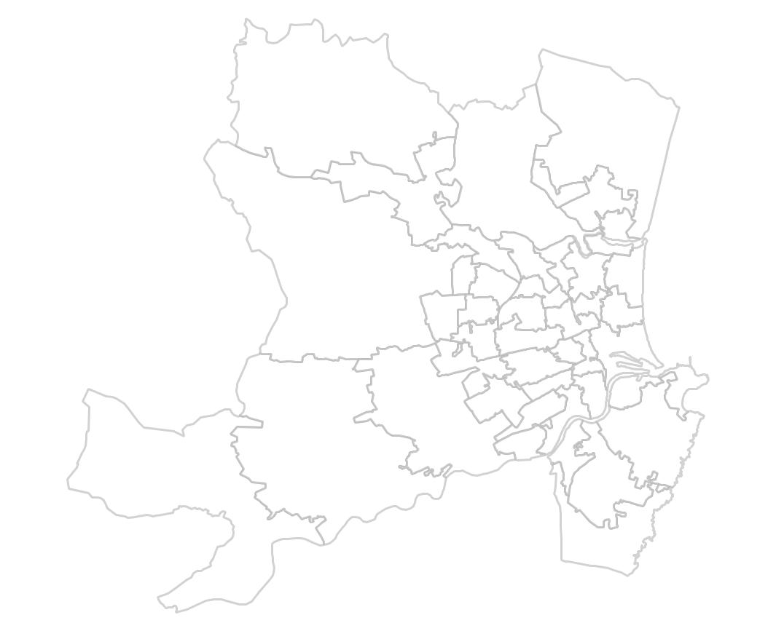
Region Growing Technique
There are many flavours of this technique
One of them is described below:
Assign seed areas to each of the segments (classes of the attribute)
Add neighbouring areas to these segments if the incoming areas have similar values of attributes
Repeat the above step until all the regions are allocated to one of the segments
Functionality to compute spatial relations i.e. neighbours are assumed.
1
1
1
1
1
1
2
2
2
2
2
2
2

Slide 14
Spatial Association Rules
Spatial objects are of major interest, not transactions
A ⇒ B
A, B can be either spatial or non-spatial

Slide 15
Multimedia Data Mining
Multimedia Data Mining is a subfield of data mining that deals with an extraction of implicit knowledge, multimedia data relationships, or other patterns not explicitly stored in multimedia databases
Multimedia Data Types
any type of information medium that can be represented, processed, stored and transmitted over network in digital form
Multi-lingual text, numeric, images, video, audio, graphical, temporal, relational, and categorical data.
Relation with conventional data mining term

Slide 16
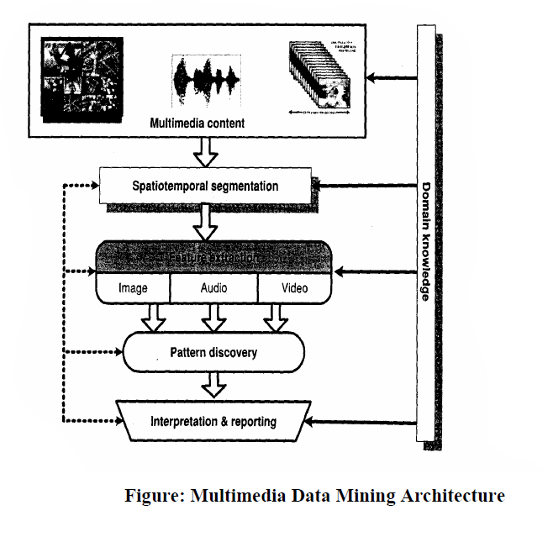

Slide 17
Generalizing Multimedia Data
Image data:
Extracted by aggregation and/or approximation
Size, color, shape, texture, orientation, and relative positions and structures of the contained objects or regions in the image
Music data:
Summarize its melody: based on the approximate patterns that repeatedly occur in the segment
Summarized its style: based on its tone, tempo, or the major musical instruments played
Video:
provide news video annotation and indexing
traffic monitoring system

Slide 18
Multidimensional Analysis of Multimedia Data
Multimedia Data Cube
Design and construction similar to that of traditional data cubes from relational data
Contain additional dimensions and measures for multimedia information, such as color, texture, and shape
The database does not store images but their descriptors.
Feature descriptor: a set of vectors for each visual characteristic
Color vector: contains the color histogram
MFC (Most Frequent Color) vector: five color centroids
MFO (Most Frequent Orientation) vector: five edge orientation centroids
Layout descriptor: contains a color layout vector and an edge layout vector

Slide 19
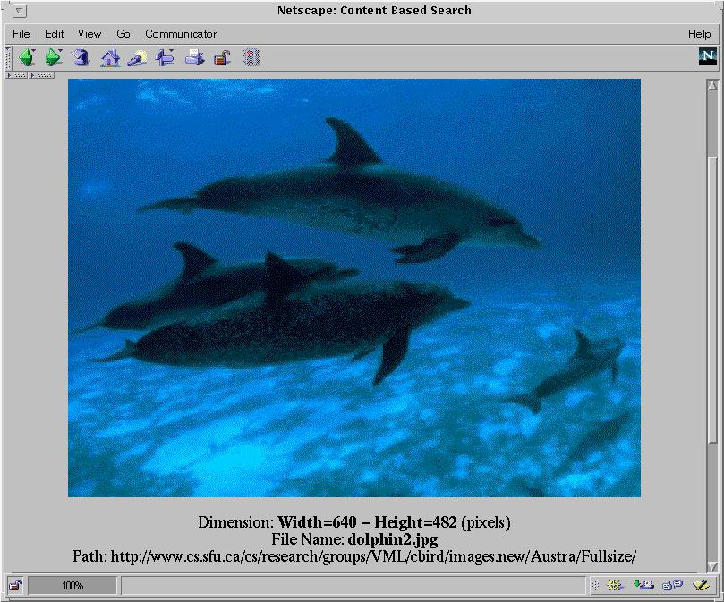
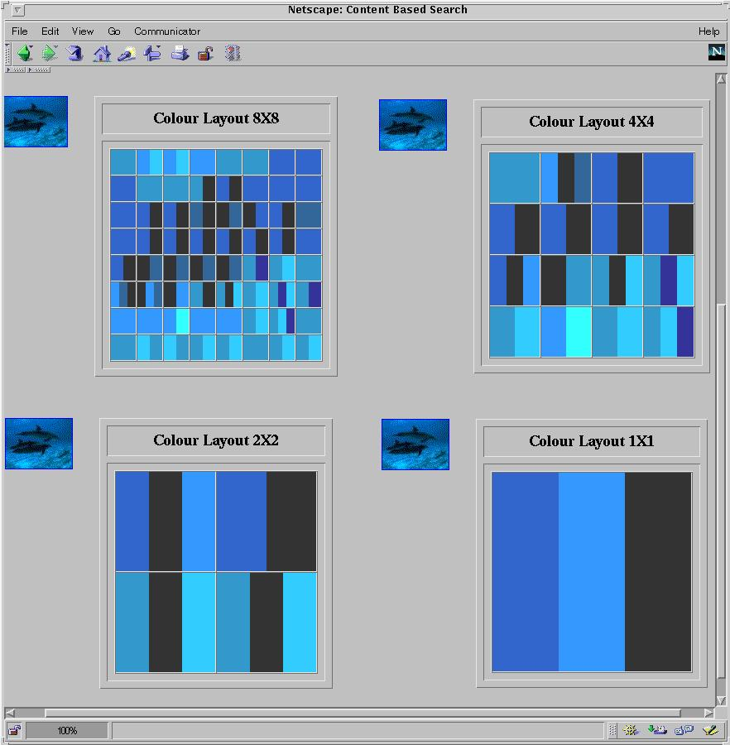
Multi-Dimensional Search in Multimedia Databases

Slide 20
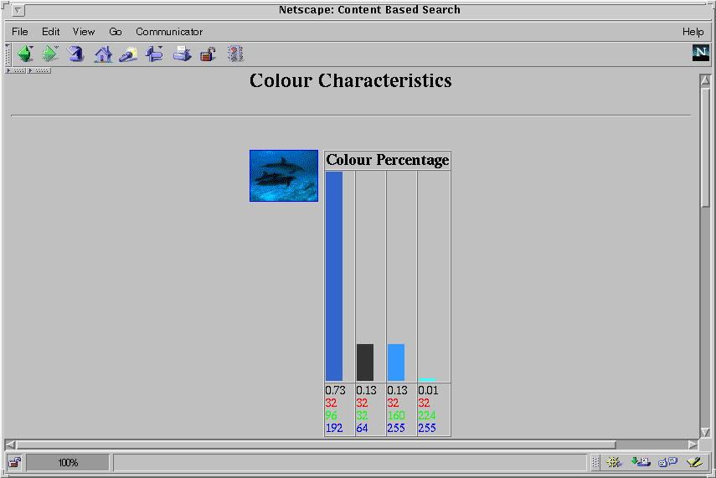
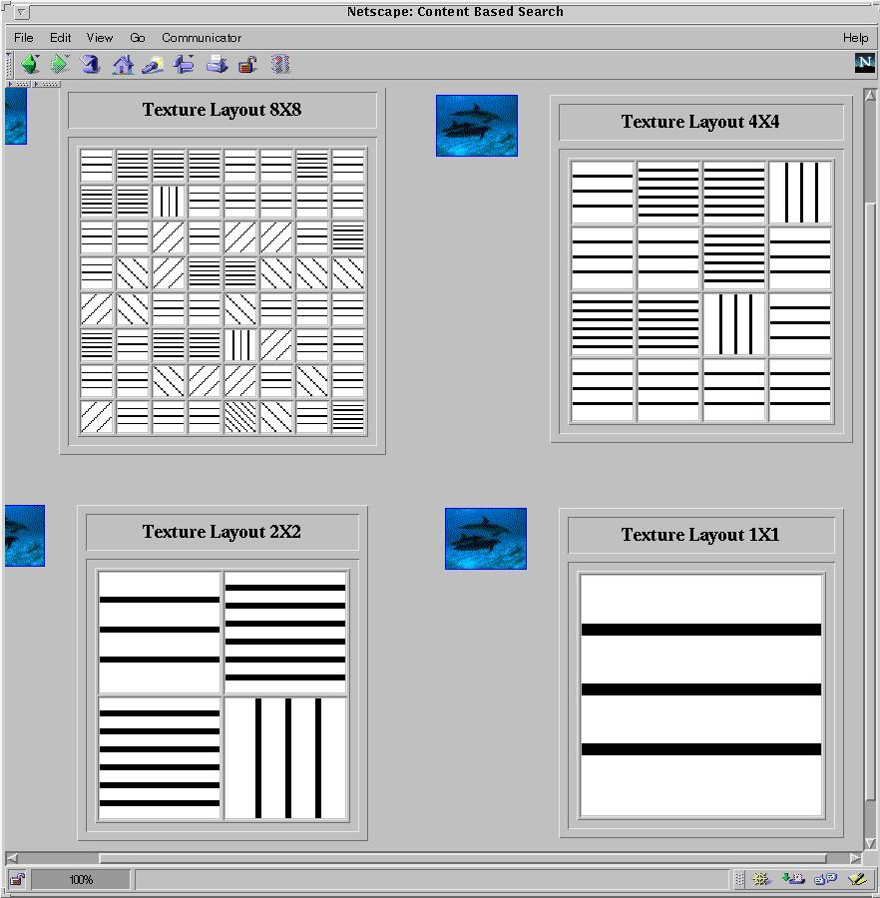
Multi-Dimensional Analysis in Multimedia Databases
Color histogram
Texture layout

Slide 21
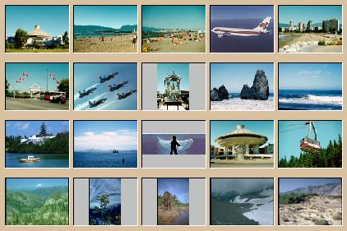


Mining Multimedia Databases
Refining or combining searches
Search for “airplane in blue sky” (top layout grid is blue and keyword = “airplane”)
Search for “blue sky and green meadows” (top layout grid is blue and bottom is green)
Search for “blue sky” (top layout grid is blue)

Slide 22

Mining Multimedia Databases
The Data Cube and
Three Dimensions
the Sub-Space Measurements
JPEG
GIF
Small
Medium
Large
By Size
Very Large
Two Dimensions
By Format
By Format & Size
RED
WHITE
Cross Tab
BLUE
By Colour
By Colour & Size
By Format & Colour
JPEG
GIF
RED
Sum
By Colour
WHITE
BLUE
By Format
Format of image
Duration
Colors
Textures
Keywords
Size
Width
Height
Internet domain of image
Internet domain of parent pages
Image popularity
Group By
Sum
Colour
RED
WHITE
BLUE
Dimensions
Measurement
Sum

Slide 23
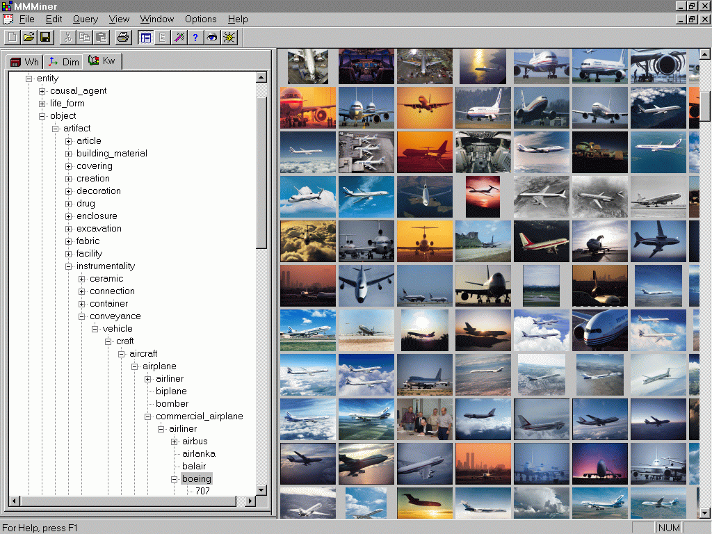
Mining Multimedia Databases in MultimediaMiner

Slide 24
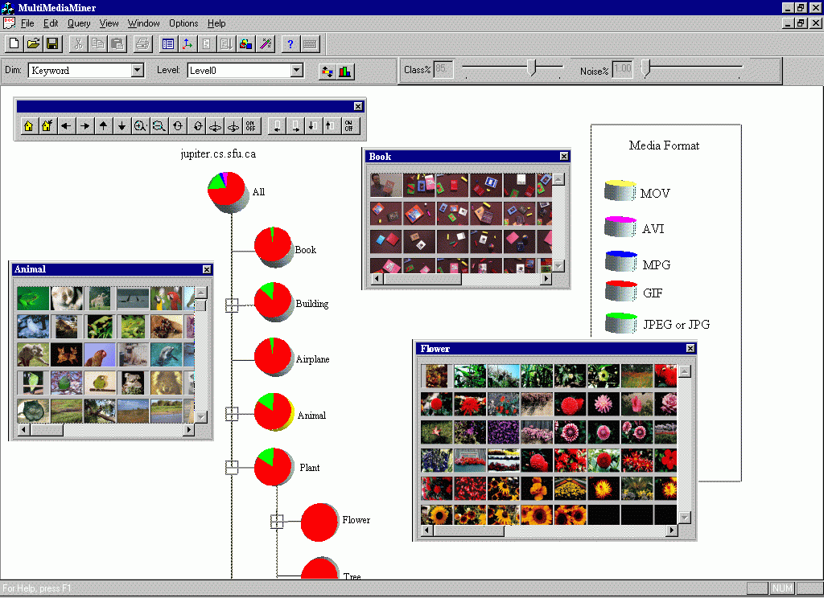
Classification in MultimediaMiner

Slide 25

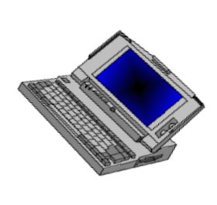

Text Mining
?
?
Internet

Slide 26
Text mining is the procedure of synthesizing information, by analyzing relations, patterns, and rules among textual data. These procedures contains text summarization, text categorization, and text clustering.
Text summarization is the procedure to extract its partial content reflecting its whole contents automatically.
Text categorization is the procedure of assigning a category to the text among categories predefined by users
Text clustering is the procedure of segmenting texts into several clusters, depending on the substantial relevance.

Slide 27
Motivation for Text Mining
Approximately 90% of the world’s data is held in unstructured formats (Source: Oracle Corporation)
Information intensive business processes demand that we transcend from simple document retrieval to “knowledge” discovery.
Structured, Numerical or Coded
Information
10%
Unstructured or Semi-structured
Information
90%

Slide 28
Text mining is well motivated, due to the fact that much of the world’s data can be found in free text form (newspaper articles, emails, literature, etc.). There is a lot of information available to mine.
While mining free text has the same goals as data mining, in general, extracting useful knowledge/stats/trends), text mining must overcome a major difficulty – there is no explicit structure.
Machines can reason will relational data well since schemas are explicitly available. Free text, however, encodes all semantic information within natural language. Our text mining algorithms, then, must make some sense out of this natural language representation. Humans are great at doing this, but this has proved to be a problem for machines.

Slide 29
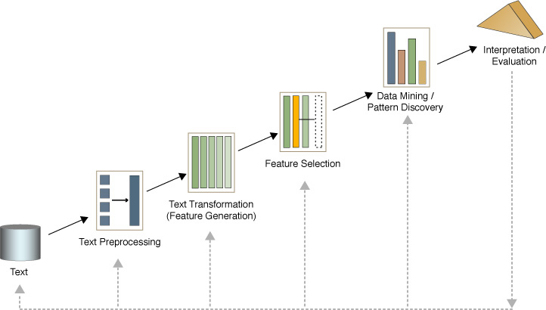
Text Mining Process

Slide 30
What’s Text Mining
Sample
Documents
Text document
Transformed
Learning
Representation
models
Domain specific
templates/models
Knowledge
Learning
Visualizations
Working

Slide 31

Mining Text Data: An Introduction
Data Mining / Knowledge Discovery
Structured Data Multimedia Free Text Hypertext
HomeLoan (
Loanee: Frank Rizzo
Lender: MWF
Agency: Lake View
Amount: $200,000
Term: 15 years
)
Frank Rizzo bought
his home from Lake
View Real Estate in
1992.
He paid $200,000
under a15-year loan
from MW Financial.
<a href>Frank Rizzo
</a> Bought
<a hef>this home</a>
from <a href>Lake
View Real Estate</a>
In <b>1992</b>.
<p>...
Loans($200K,[map],...)

Slide 32
Text Representation Issues
Each word has a dictionary meaning, or meanings
Run – (1) the verb. (2) the noun, in cricket
Cricket – (1) The game. (2) The insect.
Apple (the company) or apple (the fruit)
Ambiguity and context sensitivity - Each word is used in various “senses”
Tendulkar made 100 runs
Because of an injury, Tendulkar can not run and will need a runner between the wickets
Capturing the “meaning” of sentences is an important issue as well. Grammar, parts of speech, time sense could be easy!
Order of words in the query
hot dog stand in the amusement park
hot amusement stand in the dog park

Slide 33
Text Databases and IR
Text databases (document databases)
Large collections of documents from various sources: news articles, research papers, books, digital libraries, e-mail messages, and Web pages, library database, etc.
Data stored is usually semi-structured
Traditional information retrieval techniques become inadequate for the increasingly vast amounts of text data
Information retrieval
A field developed in parallel with database systems
Information is organized into (a large number of) documents
Information retrieval problem: locating relevant documents based on user input, such as keywords or example documents

Slide 34
Information Retrieval
Documents
source
Query
E.g. Spam / Text
IR
System
Document
Ranked
Documents
Document
Document

Slide 35
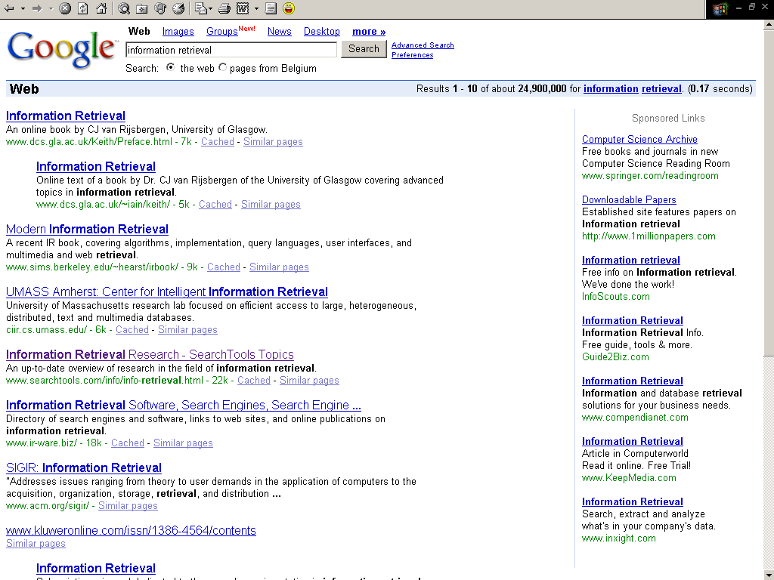

Slide 36
Basic Measures for Text Retrieval
Relevant
Relevant & Retrieved
Retrieved
All Documents
Precision: the percentage of retrieved documents that are in fact relevant to the query (i.e., “correct” responses)
Recall: the percentage of documents that are relevant to the query and were, in fact, retrieved

Slide 37
Application of Text Mining
Text mining system provides a competitive edge for a company to process and take advantage of a large quantity of textual information. The potential applications are countless. We highlight a few below.
Customer profile analysis, e.g., mining incoming emails for customers' complaint and feedback.
Patent analysis, e.g., analyzing patent databases for major technology players, trends, and opportunities.
Information dissemination, e.g., organizing and summarizing trade news and reports for personalized information services.
Company resource planning, e.g., mining a company's reports and correspondences for activities, status, and problems reported.

Slide 38
Text Mining vs. Data Mining
Data Mining Text Mining
Data Object Numerical & categorical data Textual data
Data structure Structured Unstructured &semi-structured
Data representation Straightforward Complex
Space dimension < tens of thousands > tens of thousands
Methods Data analysis, machine learning, Data mining, information
Statistic, neural networks retrieval, NLP, ...
Maturity Broad implementation since1994 Broad implementation
starting 2000
Market 10⁵ analysts at large and mid 10⁸ analysts corporate workers
size companies and individual users

Slide 39
Product : Intelligent Miner for Text(IMT)
Name Extractions
Term Extraction
Abbreviation Extraction
Relationship Extraction
Feature extraction
Categorization
Summarization
Clustering
Text Analysis
Tools
Hierarchical Clustering
IMT
Binary relational Clustering
Text search engine
Web Searching
Tools
NetQuestion Solution
Web Crawler

Slide 40
1. Feature extraction tools
It recognizes significant vocabulary items in documents, and measures their importance to the document content.
2. Clustering tools
Clustering is used to segment a document collection into subsets, called clusters.
3. Summarization tools
Summarization is the process of condensing a source text into a shorter version preserving its information content.
4. Categorization tool
Categorization is used to assign objects to predefined categories, or classes from a taxonomy.

Slide 41
Feature Extraction Tools
1.1 Information extraction
Extract linguistic items that represent document contents
1.2 Feature extraction
Assign of different categories to vocabulary in documents,
Measure their importance to the document content.
1.3 Name extraction
Locate names in text,
Determine what type of entity the name refers to
1.4 Term extraction
Discover terms in text. Multiword technical terms
Recognize variants of the same concept
1.5 Abbreviation recognition
Find abbreviation and math them with their full forms.
1.6 Relation extraction

Slide 42
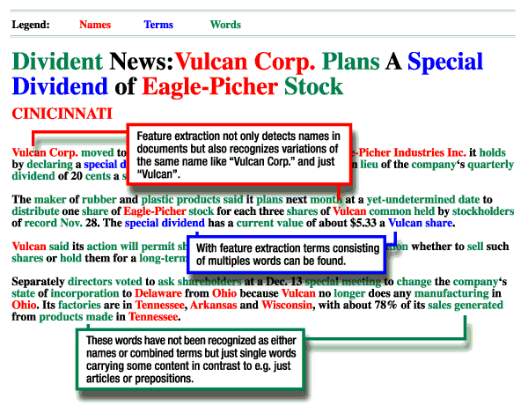
Feature Extraction Demo

Slide 43
2. Clustering Tools
2.1 Application
Provide a overview of content in a large document collection
Identify hidden structures between groups of objects
Improve the browsing process to find similar or related information
Find outstanding documents within a collection
2.2 Hierarchical clustering
Clusters are organized in a clustering tree and related clusters occurs in the same branch of tree.
2.3 Binary relational clustering
With Binary Relational Clustering, the tool finds topics hidden in a document collection and establishes links or relations between these topics.

Slide 44
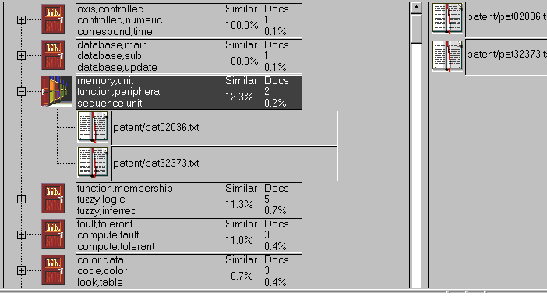
Clustering Demo: Navigation of document collection

Slide 45
3. Summarization Tools
3.1 Steps
the most relevant sentences → the relevancy of a sentence to a document
→ a summary of the document with length set by user
3.2 Applications
Judge the relevancy of a full text
Easily determine whether the document is relevant to read.
Enrich search results The results of a query to a search engine can be enriched with a short summary of each document.
Get a fast overview over document collections
summary → full document

Slide 46
4. Categorization Tool
Applications
Organize intranet documents
Assign documents to folders
Dispatch requests
Forward news to subscribers
I like health news
News
article
sports
categorizer
cultures
new router
health
politics
economics
Black cat
vacations

Slide 47
Mining World Wide Web (WWW)
The term Web Mining was coined by Orem Etzioni (1996) to denote the use of data mining techniques to automatically discover Web documents and services, extract information from Web resources, and uncover general patterns on the Web.
The World Wide Web is a rich, enormous knowledge base that can be useful to many applications. The WWW is huge, widely distributed, global information service centre for news, advertisements, consumer information, financial management, education, government, e-commerce, hyperlink information, access and usage information.
The Web’s large size and its unstructured and dynamic content, as well as its multilingual nature make extracting useful knowledge from it a challenging research problem.

Slide 48
Why Mining the World-Wide Web
Growing and changing very rapidly
Broad diversity of user communities
Only a small portion of the information on the Web is truly relevant or useful
99% of the Web information is useless to 99% of Web users
How can we find high-quality Web pages on a specified topic?

Slide 49
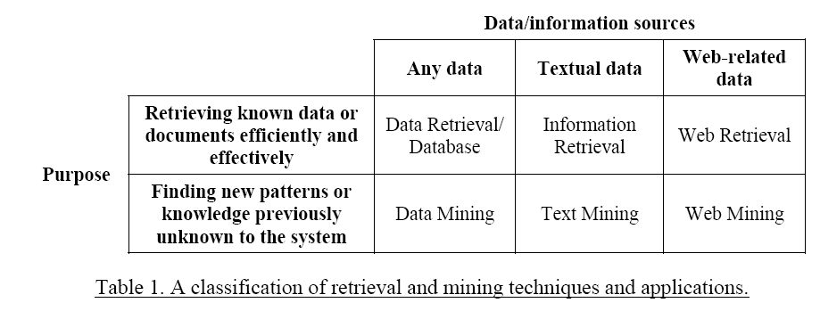
Web mining research overlaps substantially with other areas, including data mining, text mining, information retrieval, and web retrieval.

Slide 50
Web Search Engines
Index-based: search the Web, index Web pages, and build and store huge keyword-based indices
Help locate sets of Web pages containing certain keywords
Deficiencies
A topic of any breadth may easily contain hundreds of thousands of documents
Many documents that are highly relevant to a topic may not contain keywords defining them (polysemy)

Slide 51
Web Mining: A More Challenging Task
Searches for
Web access patterns
Web structures
Regularity and dynamics of Web contents
Problems
The “abundance” problem
Limited coverage of the Web: hidden Web sources, majority of data in DBMS
Limited query interface based on keyword-oriented search
Limited customization to individual users

Slide 52
Web Mining Taxonomy
Web Mining
Web Content
Mining
Web Structure
Mining
Web Usage
Mining
Web Page
Content Mining
Search Result
Mining
General Access
Pattern Tracking
Customized
Usage Tracking
Web Mining research can be classified into three categories:
Web content mining refers to the discovery of useful information from Web contents, including text, images, audio, video, etc.
Web structure mining studies the model underlying the link structures of the Web. It has been used for search engine result ranking and other Web applications.
Web usage mining focuses on using data mining techniques to analyze search logs to find interesting patterns. One of the main applications of Web usage mining is its use to learn user profiles.

Slide 53
Mining the World-Wide Web
Web Mining
Web Content
Mining
Web Structure
Mining
Web Usage
Mining
Web Page Content Mining
Web Page Summarization
WebLog (Lakshmanan et.al. 1996), WebOQL(Mendelzon et.al. 1998) …:
Web Structuring query languages;
Can identify information within given web pages
Ahoy! (Etzioni et.al. 1997):Uses heuristics to distinguish personal home pages from other web pages
ShopBot (Etzioni et.al. 1997): Looks for product prices within web pages
Search Result
Mining
General Access
Pattern Tracking
Customized
Usage Tracking

Slide 54
Mining the World-Wide Web
Web Mining
Web Content
Mining
Web Structure
Mining
Web Usage
Mining
Web Page
Content Mining
Search Result Mining
Search Engine Result Summarization
Clustering Search Result (Leouski and Croft, 1996, Zamir and Etzioni, 1997):
Categorizes documents using phrases in titles and snippets
General Access
Pattern Tracking
Customized
Usage Tracking

Slide 55
Mining the World-Wide Web
Web Mining
Web Content
Mining
Web Usage
Mining
Web Structure Mining
Using Links
PageRank (Brin et al., 1998)
CLEVER (Chakrabarti et al., 1998)
Use interconnections between web pages to give weight to pages.
Using Generalization
MLDB (1994), VWV (1998)
Uses a multi-level database representation of the Web. Counters (popularity) and link lists are used for capturing structure.
Search Result
Mining
General Access
Pattern Tracking
Web Page
Content Mining
Customized
Usage Tracking

Slide 56
Mining the World-Wide Web
Web Mining
Web Content
Mining
Web Structure
Mining
Web Usage
Mining
Web Page
Content Mining
General Access Pattern Tracking
Web Log Mining (Zaïane, Xin and Han, 1998)
Uses KDD techniques to understand general access patterns and trends.
Can shed light on better structure and grouping of resource providers.
Customized
Usage Tracking
Search Result
Mining

Slide 57
Mining the World-Wide Web
Web Mining
Web Content
Mining
Web Structure
Mining
Web Usage
Mining
Web Page
Content Mining
General Access
Pattern Tracking
Customized Usage Tracking
Adaptive Sites (Perkowitz and Etzioni, 1997)
Analyzes access patterns of each user at a time.
Web site restructures itself automatically by learning from user access patterns.
Search Result
Mining

Slide 58
Web Usage Mining
Web servers, Web proxies, and client applications can quite easily capture Web Usage data.
Web server log: Every visit to the pages, what and when files have been requested, the IP address of the request, the error code, the number of bytes sent to user, and the type of browser used…
By analyzing the Web usage data, web mining systems can discover useful knowledge about a system’s usage characteristics and the users’ interests which has various applications:
Personalization and Collaboration in Web-based systems
Marketing
Web site design and evaluation
Decision support (e.g., Chen & Cooper, 2001; Marchionini, 2002).

Slide 59
Mining Web log records to discover user access patterns of Web pages
Applications
Target potential customers for electronic commerce
Enhance the quality and delivery of Internet information services to the end user
Improve Web server system performance
Identify potential prime advertisement locations
Web logs provide rich information about Web dynamics
Typical Web log entry includes the URL requested, the IP address from which the request originated, and a timestamp

Slide 60
Why Web Usage Mining?
Explosive growth of E-commerce
Provides an cost-efficient way doing business
Amazon.com: “online Wal-Mart”
Hidden Useful information
Visitors’ profiles can be discovered
Measuring online marketing efforts, launching marketing campaigns, etc.

Slide 61
Mining the World-Wide Web
Design of a Web Log Miner
Web log is filtered to generate a relational database
A data cube is generated form database
OLAP is used to drill-down and roll-up in the cube
OLAM is used for mining interesting knowledge
Knowledge
Web log
Database
Data Cube
Sliced and diced
cube
1
Data Cleaning
2
Data Cube
Creation
3
OLAP
4
Data Mining

Slide 62
Web usage mining has been used for various purposes:
A knowledge discovery process for mining marketing intelligence information from Web data. Buchner and Mulvenna (1998)
Web traffic patterns also can be extracted from Web usage logs in order to improve the performance of a Web site (Cohen et al., 1998).
Commercial products: Web Trends developed by NetIQ, WebAnalyst by Megaputer and NetTracker by Sane Solutions.
Search engine transaction logs also provide valuable knowledge about user behavior on Web searching.
Such information is very useful for a better understanding of users’ Web searching and information seeking behavior and can improve the design of Web search systems.

Slide 63
One of the major goals of Web usage mining is to reveal interesting trends and patterns which can often provide important knowledge about the users of a system.
The Framework for Web usage mining. Srivastava et al. (2000)
Preprocessing: Data cleansing
Pattern discovery:
Pattern analysis:
Generic machine learning and Data mining techniques, such as association rule mining, classification, and clustering, often can be applied.

Slide 64
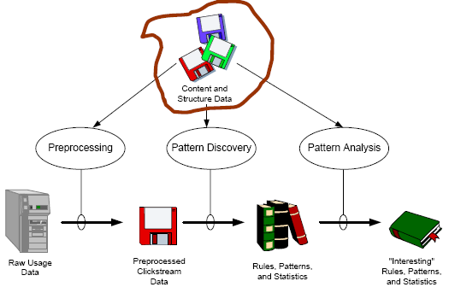
Web Usage Mining - Procedure

Slide 65
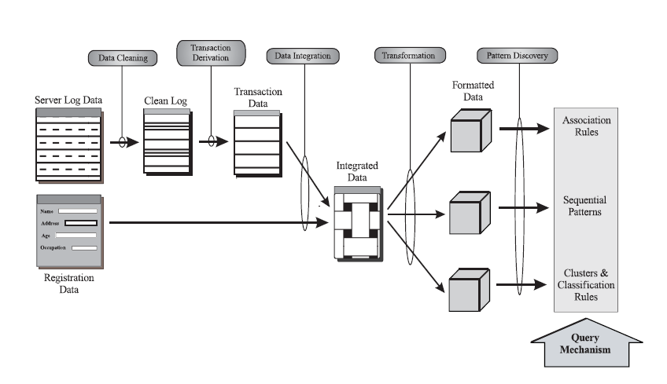
Web Usage Mining - Model

Slide 66
Many Web applications aim to provide personalized information and services to users. Web usage data provide an excellent way to learn about users’ interest (Srivastava et al., 2000).
WebWatcher (Armstrong et al., 1995)
Letizia (Lieberman, 1995)
Web usage mining on Web logs can help identify users who have accessed similar Web pages. The patterns that emerge can be very useful in collaborative Web searching and filtering.
Amazon.com uses collaborative filtering to recommend books to potential customers based on the preferences of other customers having similar interests or purchasing histories.
Huang et al. (2002) used Hopfield Net to model user interests and product profiles in an online bookstore in Taiwan.

Slide 67
How to perform Web Usage Mining
Obtain web traffic data from
Web server log files
Corporate relational databases
Registration forms
Apply data mining techniques and other Web mining techniques
Two categories:
Pattern Discovery Tools
Pattern Analysis Tools

Slide 68
Pattern Analysis Tools
Answer Questions like:
“How are people using this site?”
“which Pages are being accessed most frequently?”
This requires the analysis of the structure of hyperlinks and the contents of the pages

Slide 69
Pattern Discovery Tools
Data Pre-processing
Filtering/clean Web log files
eliminate outliers and irrelevant items
Integration of Web Usage data from:
Web Server Logs
Referral logs
Registration file
Corporate Database
Converting IP addresses to Domain Names
Domain Name System does the conversion
Discover information from visitors’ domain names:
Ex: .ca(Canada), .cn(China), etc
Converting URLs to Page Titles
Page Title: between <title> and </title>

Slide 70
Pattern Discovery Techniques
Path Analysis
Uses Graph Model
Provide insights to navigational problems
Example of info. Discovered by Path analysis:
78% “company”-> “what’s new”->“sample”-> “order”
60% left sites after 4 or less page references
=> most important info must be within the first 4 pages of site entry points.
Grouping
Groups similar info. to help draw higher-level conclusions
Ex: all URLs containing the word “Yahoo”…
Filtering
Allows to answer specific questions like:
how many visitors to the site in this week?

Slide 71
Pattern Discovery Techniques
Dynamic Site Analysis
Dynamic html links to the database, and requires parameters appended to URLs
http://search.netscape.com/cgi-in/search?search=Federal+Tax+Return+Form&cp=ntserch
Knowledge:
What the visitors looked for
What keywords S/B purchased from Search engineer
Cookies
Randomly assigned ID by web server to browser
Cookies are beneficial to both web site developers and visitors
Cookie field entry in log file can be used by Web traffic analysis software to track repeat visitors → loyal customers.

Slide 72
Pattern Discovery Techniques
Association Rules
help find spending patterns on related products
30% who accessed/company/products/bread.html, also accessed /company/products/milk.htm.
Sequential Patterns
help find inter-transaction patterns
50% who bought items in /pcworld/computers/, also bought in /pcworld/accessories/ within 15 days
Clustering
Identifies visitors with common characteristics based on visitors’ profiles
50% who applied discover platinum card in /discovercard/customerService/newcard, were in the 25-35 age group, with annual income between $40,000 – 50,000.

Slide 73
Pattern Discovery Techniques
Decision Trees
a flow chart of questions leading to a decision
Ex: car buying decision tree
What Brand?
2000 Model Honda
Accord EX …
What Year?
What Type?

Slide 74
Web Content Mining
Text Mining for Web Documents
Text mining for Web documents can be considered a sub-field of Web content mining.
Information extraction techniques have been applied to Web HTML documents
E.g., Chang and Lui (2001) used a PAT tree to construct automatically a set of rules for information extraction.
Text clustering algorithms also have been applied to Web applications.
E.g., Chen et al. (2001; 2002) used a combination of noun phrasing and SOM to cluster the search results of search agents that collect Web pages by meta-searching popular search engines.

Slide 75
Web Structure Mining
Web link structure has been widely used to infer important web pages information.
Web structure mining has been largely influenced by research in
Social network analysis
Citation analysis (bibliometrics).
in-links: the hyperlinks pointing to a page
out-links: the hyperlinks found in a page.
Usually, the larger the number of in-links, the better a page is.
By analyzing the pages containing a URL, we can also obtain
Anchor text: how other Web page authors annotate a page and can be useful in predicting the content of the target page.

Slide 76
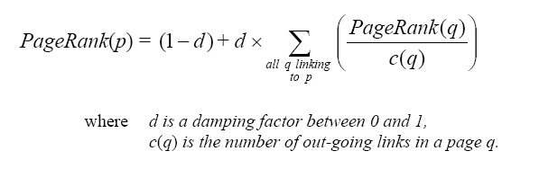
Web structure mining algorithms:
The PageRank algorithm is computed by weighting each in-link to a page proportionally to the quality of the page containing the in-link (Brin & Page, 1998).
The qualities of these referring pages also are determined by PageRank. Thus, a page p is calculated recursively as follows:

Slide 77
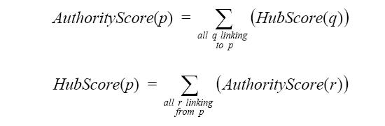
Web structure mining algorithms:
Kleinberg (1998) proposed the HITS (Hyperlink-Induced Topic Search) algorithm, which is similar to PageRank.
Authority pages: high-quality pages related to a particular search query.
Hub pages: pages provide pointers to other authority pages.
A page to which many others point should be a good authority, and a page that points to many others should be a good hub.

Slide 78
Another application of Web structure mining is to understand the structure of the Web as a whole.
The core of the Web is a strongly connected component and that the Web’s graph structure is shaped like a bowtie. Broder et al. (2000)
Strongly Connected Component (SCC); 28% of the Web.
IN: every Web page contains a direct path to the SCC; 21% of Web
OUT: a direct path from SCC linking to it; 21% of Web
TENDRILS: pages hanging off from IN and OUT but without direct path to SCC; 22% of Web
Isolated, Disconnected Components that are not connected to the other 4 groups; 8% of Web

Slide 79
Conclusion
Spatial data mining is facilitated by Spatial warehousing, OLAP and mining and finds spatial associations, classifications and trends.
Multimedia data mining needs content-based retrieval and similarity search integrated with mining methods
Text mining goes beyond keyword-based and similarity-based information retrieval and discovers knowledge from semi-structured data using methods like keyword-based association and document classification.
Web mining includes mining Web link structures to identify authoritative Web pages, the automatic classification of Web documents, building a multilayered Web information base, and Weblog mining.

Slide 80
Questions?

Slide 81
References
D. Pyle. Data Preparation for Data Mining. Morgan Kaufmann, 1999.
Petrushin, Valery A: Introduction into Multimedia Data Mining and Knowledge Discovery. Edited by Valery A Petrushin and Latifur Khan. London: Springer-Verlag, 2007. P. 3-13.J.
Han and M. Kamber. Data Mining: Concepts and Techniques. Morgan Kaufmann, 2000.
Web Mining Research: A Survey – Raymond Kosala, Hendrik Blockeel Dept of CS Katholieke Universiteit Leuven
W. H. Inmon. Building the Data Warehouse. John Wiley, 1996
R. Kimball and M. Ross. The Data Warehouse Toolkit: The Complete Guide to Dimensional Modeling. 2ed. John Wiley, 2002
S. Chakrabarti, “Mining the Web: Statistical Analysis of Hypertext and Semi-Structured Data”, Morgan Kaufmann, 2002.

Slide 82
End of Unit 7

Slide 83
Thank you !!!

